Slide 1










Prediction

Slide 2

SPARK
Phạm Ngọc Hải
Lương Đức Anh
Hoàng Đình Duy
Nguyễn Văn Thắng
Aggregations

Slide 3
SPARK
Phạm Ngọc Hải
Lương Đức Anh
Hoàng Đình Duy
Nguyễn Văn Thắng
Aggregations

Slide 4
Contents
Aggregations
1. Aggregation Functions
2. Grouping
3. Windown Functions
4. Grouping Sets
5. Uses Defined Aggregation Functions

Slide 5
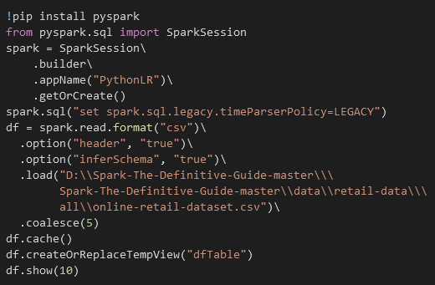
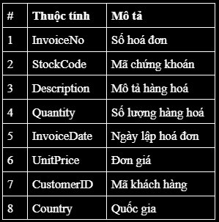
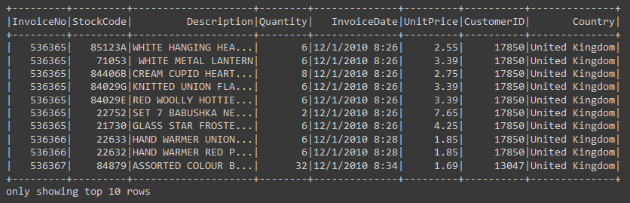
Import data
Aggregation Functions
1. Aggregation Functions
2. Grouping
3. Windown Functions
4. Grouping Sets
5. Uses Defined Aggregation Functions

Slide 6




COUNT & count Distinct
Aggregation Functions
1. Aggregation Functions
2. Grouping
3. Windown Functions
4. Grouping Sets
5. Uses Defined Aggregation Functions

Slide 7


Approx count distinct
Aggregation Functions
1. Aggregation Functions
2. Grouping
3. Windown Functions
4. Grouping Sets
5. Uses Defined Aggregation Functions

Slide 8




first & last - min & max
Aggregation Functions
1. Aggregation Functions
2. Grouping
3. Windown Functions
4. Grouping Sets
5. Uses Defined Aggregation Functions

Slide 9




sum & sum Distinct
Aggregation Functions
1. Aggregation Functions
2. Grouping
3. Windown Functions
4. Grouping Sets
5. Uses Defined Aggregation Functions

Slide 10
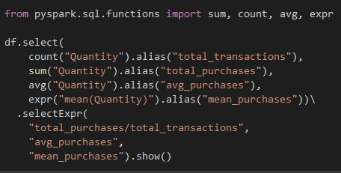
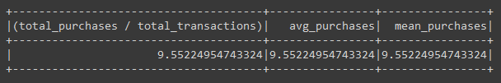
average
Aggregation Functions
1. Aggregation Functions
2. Grouping
3. Windown Functions
4. Grouping Sets
5. Uses Defined Aggregation Functions

Slide 11


Variance & Standard Deviation
Aggregation Functions
1. Aggregation Functions
2. Grouping
3. Windown Functions
4. Grouping Sets
5. Uses Defined Aggregation Functions

Slide 12

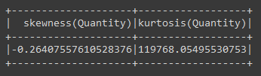
skewness & kurtosis
Aggregation Functions
1. Aggregation Functions
2. Grouping
3. Windown Functions
4. Grouping Sets
5. Uses Defined Aggregation Functions

Slide 13


Covariance & Correlation
Aggregation Functions
1. Aggregation Functions
2. Grouping
3. Windown Functions
4. Grouping Sets
5. Uses Defined Aggregation Functions

Slide 14

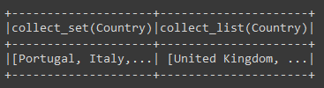
Aggregating to Complex Types
Aggregation Functions
1. Aggregation Functions
2. Grouping
3. Windown Functions
4. Grouping Sets
5. Uses Defined Aggregation Functions

Slide 15
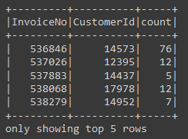
group by
Grouping
1. Aggregation Functions
2. Grouping
3. Windown Functions
4. Grouping Sets
5. Uses Defined Aggregation Functions

Slide 16
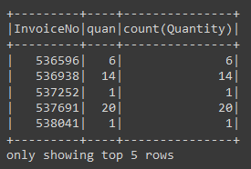
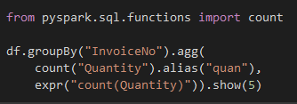
group by with Expressions
Grouping
1. Aggregation Functions
2. Grouping
3. Windown Functions
4. Grouping Sets
5. Uses Defined Aggregation Functions

Slide 17
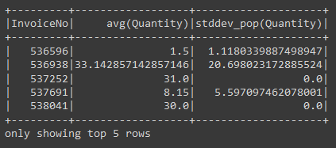

group by with Maps
Grouping
1. Aggregation Functions
2. Grouping
3. Windown Functions
4. Grouping Sets
5. Uses Defined Aggregation Functions

Slide 18
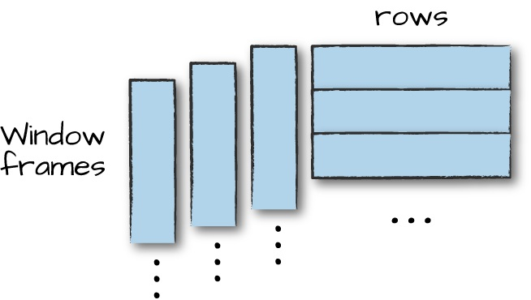
rows & window frames
Window Functions
1. Aggregation Functions
2. Grouping
3. Windown Functions
4. Grouping Sets
5. Uses Defined Aggregation Functions

Slide 19
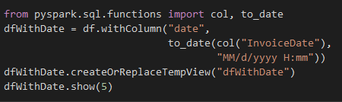
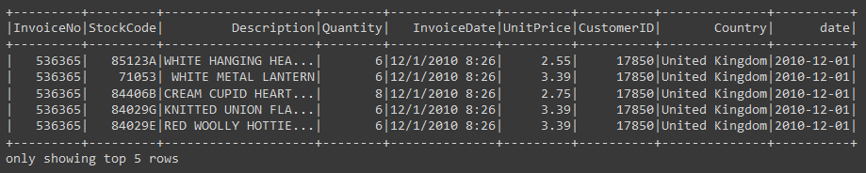
rows & window frames
Window Functions
1. Aggregation Functions
2. Grouping
3. Windown Functions
4. Grouping Sets
5. Uses Defined Aggregation Functions

Slide 20
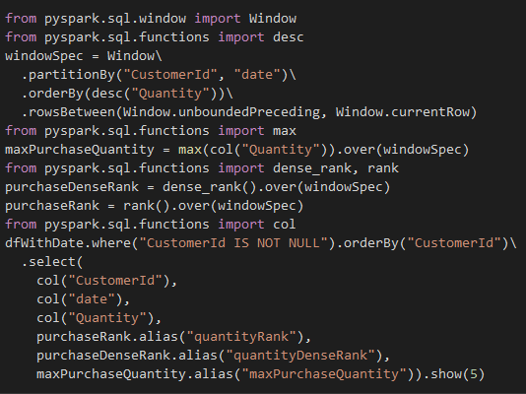
Create frames with window functions
Window Functions
1. Aggregation Functions
2. Grouping
3. Windown Functions
4. Grouping Sets
5. Uses Defined Aggregation Functions

Slide 21
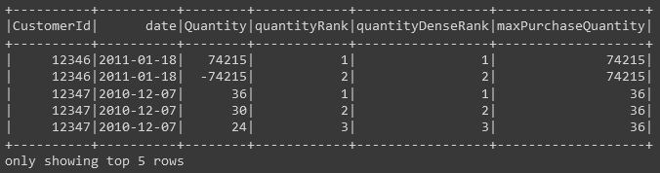
Create frames with window functions
Window Functions
1. Aggregation Functions
2. Grouping
3. Windown Functions
4. Grouping Sets
5. Uses Defined Aggregation Functions

Slide 22
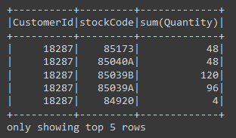
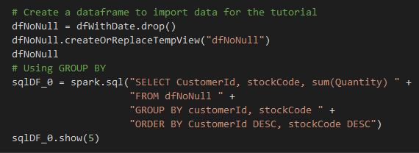
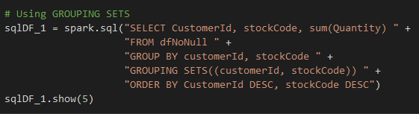
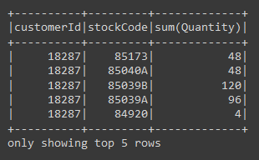
GROUP BY compare to Grouping Sets
Grouping Sets
1. Aggregation Functions
2. Grouping
3. Windown Functions
4. Grouping Sets
5. Uses Defined Aggregation Functions

Slide 23

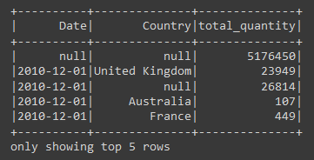
Rollups
Grouping Sets
1. Aggregation Functions
2. Grouping
3. Windown Functions
4. Grouping Sets
5. Uses Defined Aggregation Functions

Slide 24

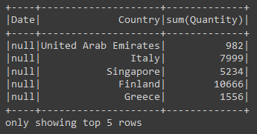
Cube
Grouping Sets
1. Aggregation Functions
2. Grouping
3. Windown Functions
4. Grouping Sets
5. Uses Defined Aggregation Functions

Slide 25
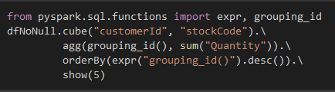
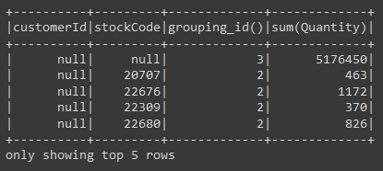
Grouping Metadata
Grouping Sets
1. Aggregation Functions
2. Grouping
3. Windown Functions
4. Grouping Sets
5. Uses Defined Aggregation Functions

Slide 26

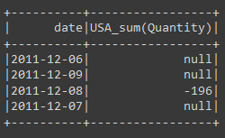
Pivot
Grouping Sets
1. Aggregation Functions
2. Grouping
3. Windown Functions
4. Grouping Sets
5. Uses Defined Aggregation Functions

Slide 27
about UDAF
User-Defined Aggregation Functions
inputSchemarepresents input arguments as a StructType
bufferSchemarepresents intermediate UDAF results as a StructType
dataTyperepresents the return DataType
deterministicis a Boolean value that specifies whether this UDAF will return the same result for a given input
initializeallows you to initialize values of an aggregation buffer
updatedescribes how you should update the internal buffer based on a given row
mergedescribes how two aggregation buffers should be merged
evaluatewill generate the final result of the aggregation

Slide 28
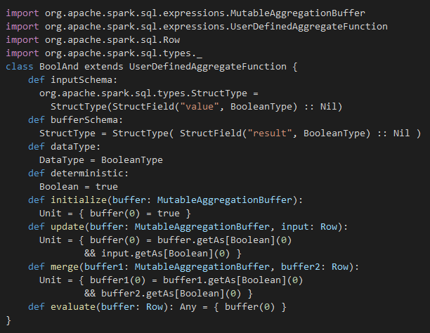
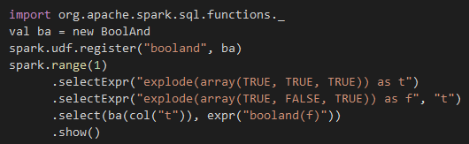
eg about UDAF
User-Defined Aggregation Functions
inputSchema: StructType
bufferSchema: StructType
dataType: DataType
deterministic: DataOfInput
initialize: aggregation buffer
update: internal buffer
merge: aggregation buffers
evaluate: final result of the aggregation

Slide 29
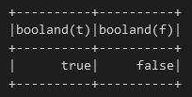
eg about UDAF
User-Defined Aggregation Functions
inputSchemarepresents input arguments as a StructType
bufferSchemarepresents intermediate UDAF results as a StructType
dataTyperepresents the return DataType
deterministicis a Boolean value that specifies whether this UDAF will return the same result for a given input
initializeallows you to initialize values of an aggregation buffer
updatedescribes how you should update the internal buffer based on a given row
mergedescribes how two aggregation buffers should be merged
evaluatewill generate the final result of the aggregation

Slide 30

Thank You
Q&A
contact us
harito9703@gmail.com

